Slide 1

Web scraping to gain company insights
26/04/2023

Slide 2
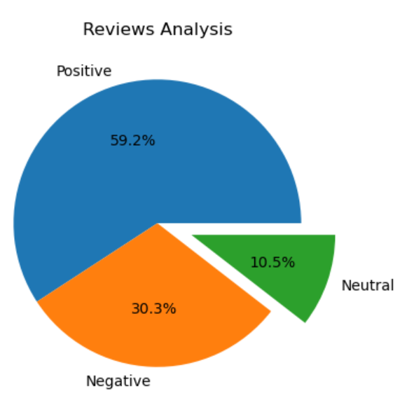
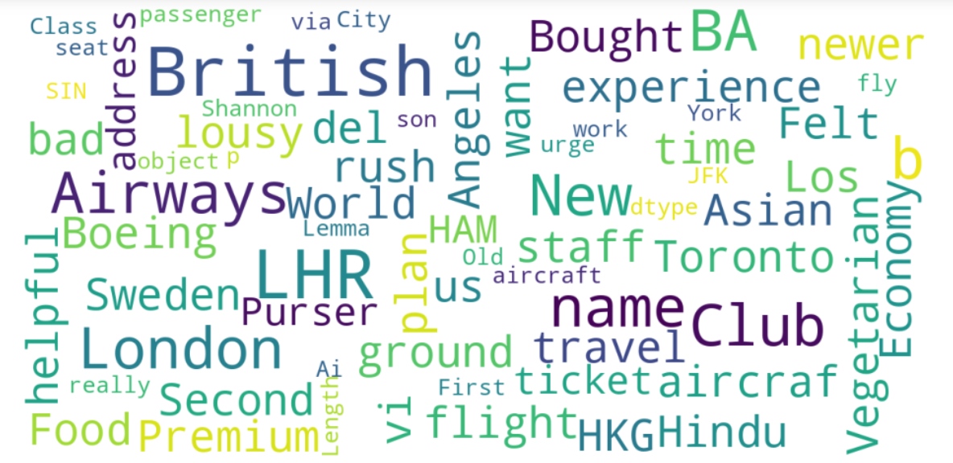
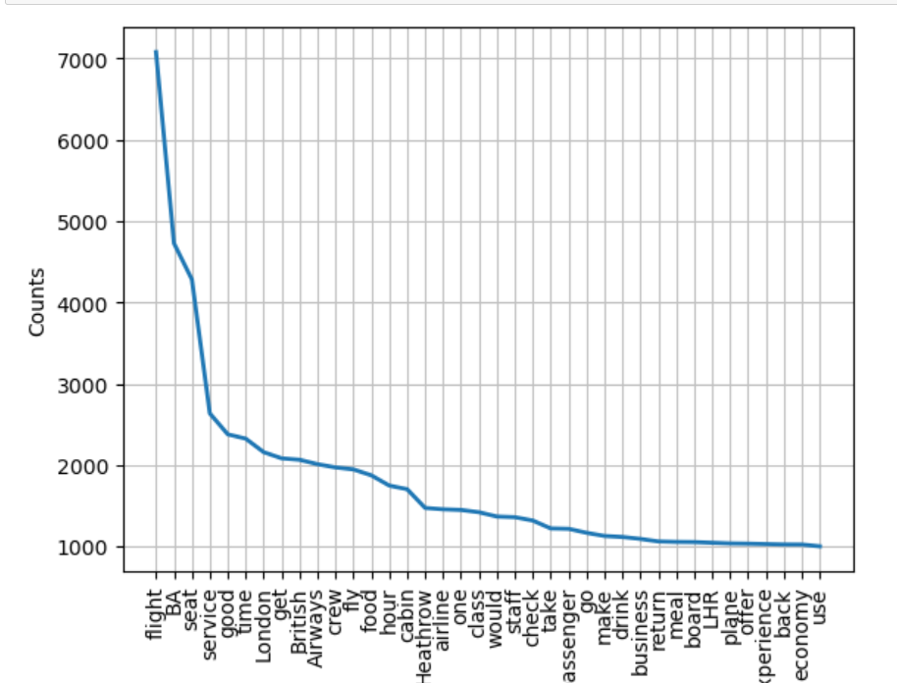
INSIGHTS FROM CUSTOMER REVIEWS
From cleaning 3536 reviews given by the customers, we obtained
Positive Reviews - 2093
Negative Reviews - 1072
Neutral Reviews – 371
Word cloud of keywords used in reviews

